Slide 1

The Need for Experiment Management in Machine Learning
Leveraging MLFlow and Linux-Based Workstations for Efficient Experimentation

Slide 2

Scenario Overview
Task: Develop a skin lesion classification model.
Benchmark: Existing organizational model with 80% accuracy.
Approach: Conduct several experiments to improve performance.

Slide 3
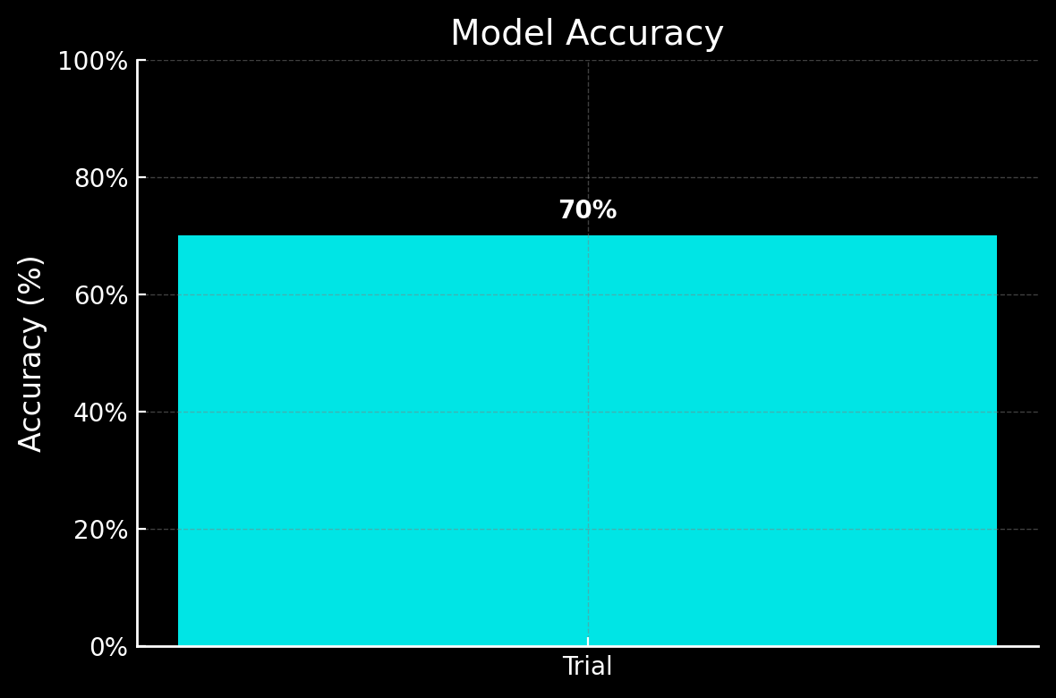
First attempt
Notes:
Tuhin made his First attempt. But his accuracy is only 70%...

Slide 4
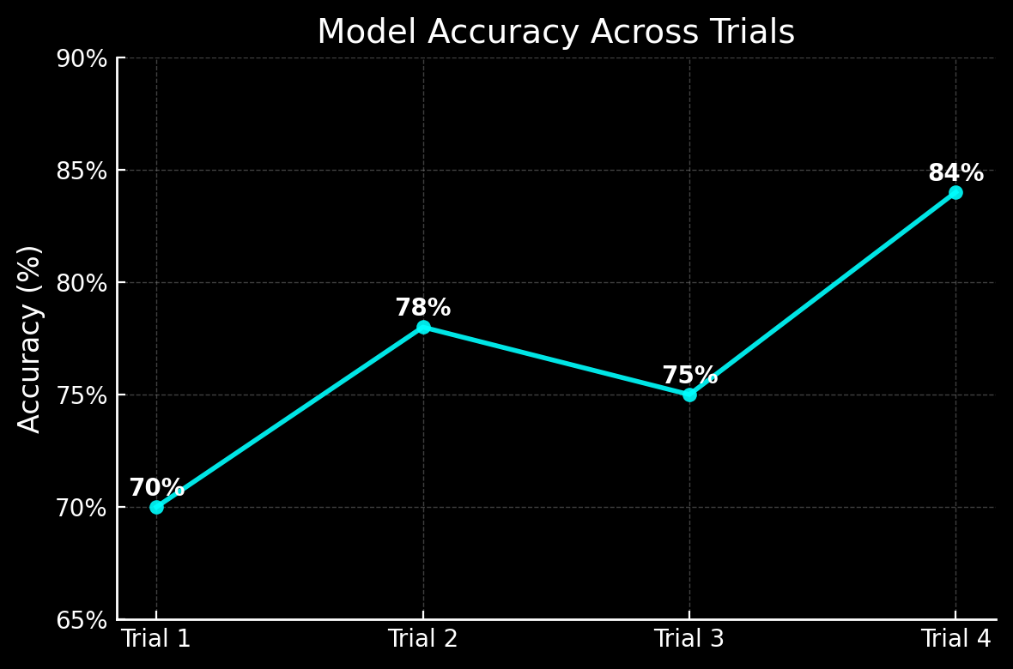
Tweaks parameters and trains a new model.
Fourth Attempt
Notes:
He decides to run multiple experiments before submitting his results. After his fourth attempt, he outperforms the current model!

Slide 5
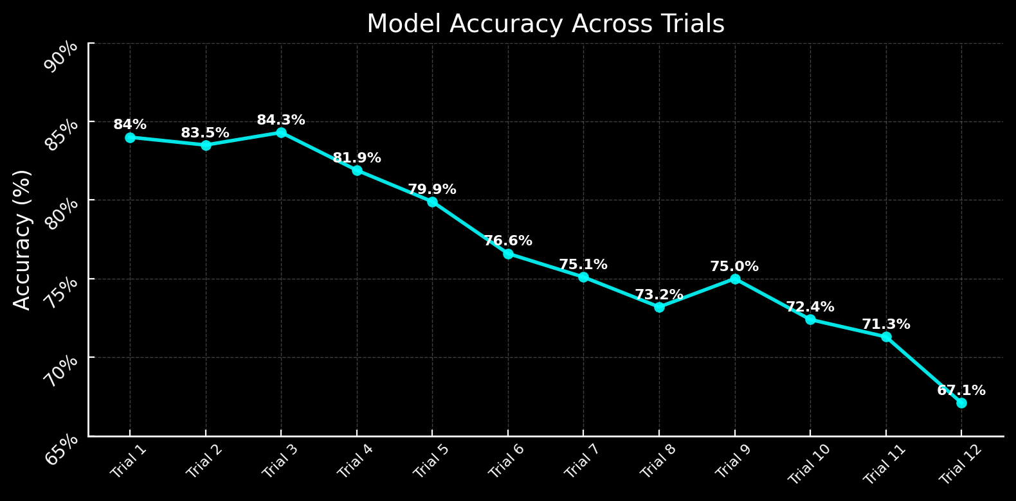
More Experiments
Final Attempt
Notes:
- Ran multiple experiments with varying hyperparameters, model configurations, and fine-tuning techniques.
- After initial success, faced regression in performance.

Slide 6
Tries to recall
Revert to best solution
Notes:
- Needs to revert to an earlier successful experiment but could not recall parameters or configurations used.

Slide 7

The Solution
Experiment Management with MLflow
- Tracks hyperparameters, metrics, and artifacts.
- Enables easy comparison of experiments.
- Supports reproducibility, model registry, and versioning.

Slide 8
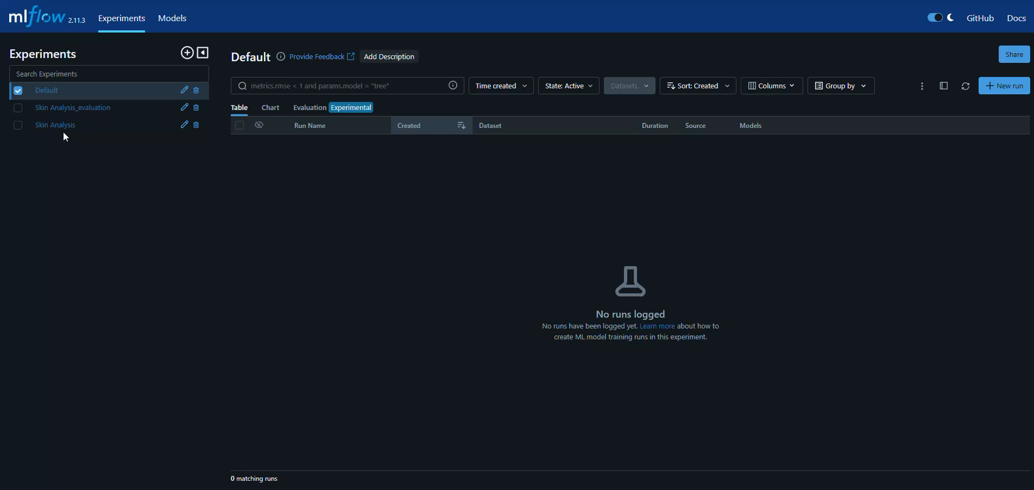
Scenario with mlflow
- Each experiment is automatically logged.
- Enables effortless reversion to the experiment with better results.
- Provides access to all relevant configuration details.

Slide 9
Why Linux-Based Workstations?

Slide 10
Why Linux-Based Workstations?
- Optimized performance for machine learning workflows.
- Access to powerful open-source tools and libraries.
- Robust support for distributed systems.
- Streamlined integration with MLflow and other tools.

Slide 11
Final tips & takeaways
- Manual experiment tracking is inefficient and error-prone.
- MLflow simplifies, structures, and accelerates experimentation.
- Linux-based workstations unleash the full potential of ML workflows.

Slide 12

Thank you

